Slide 1
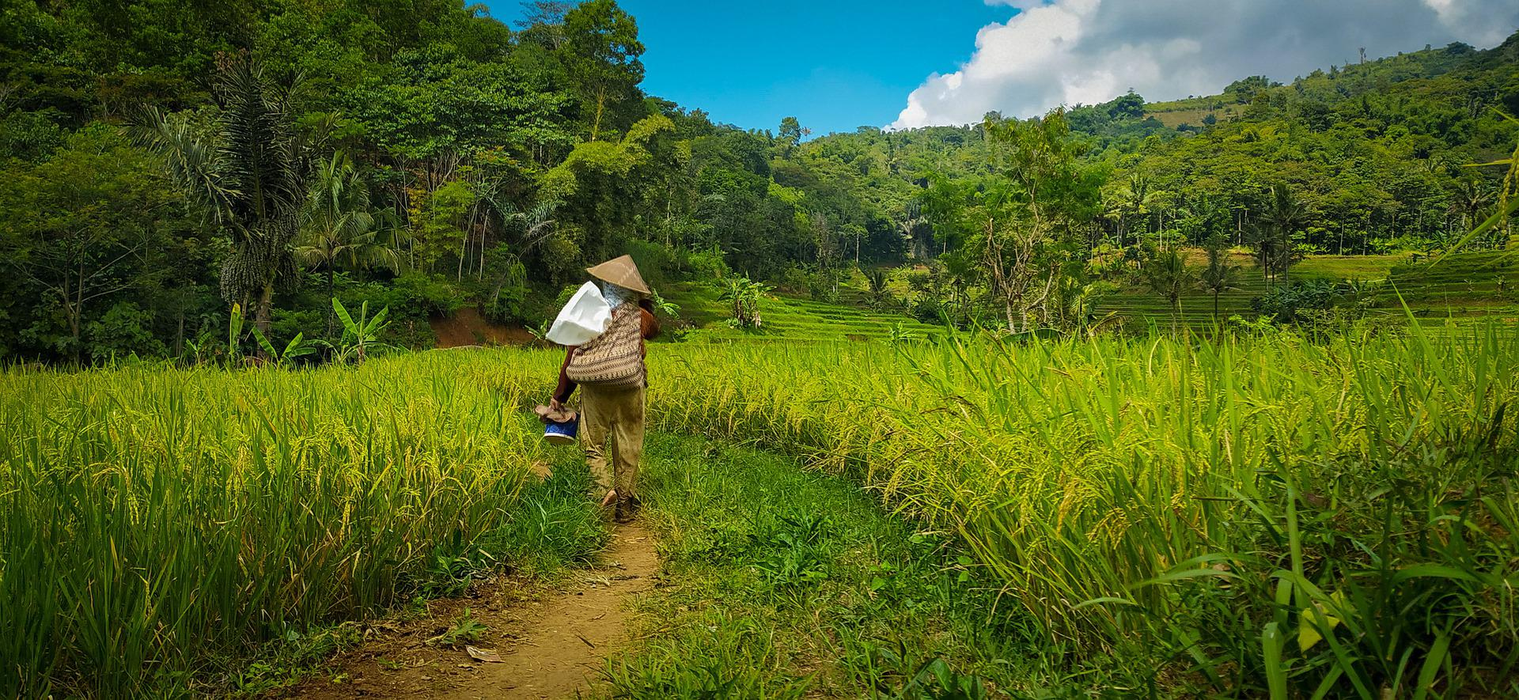
GLOBAL FOREST COALITION AT COP27
Sharm El-Sheikh, 6-18 NOV 2022
#OurNatureIsNotYourSolution
#DecolonizeClimateSolutions
#StopFinancingFactoryFarming
Notes:
Welcome everyone to this webinar

Slide 2
Topline messages
We demand an end to false forest-related climate change solutions - including biofuels/biomass, commercial monoculture tree plantations, Carbon Capture and Storage in particular Bioenergy with Carbon Capture and Storage (BECCS), Genetic Engineering, REDD, biodiversity offsets, and carbon trading.
Frontline forest communities—Indigenous Peoples, local communities, women, gender-diverse people, children, youth, farmers, and peasants—are fighting a battle to survive, and protect their territories, food sovereignty, and livelihoods from both climate change as well as the impacts of false forest-related climate change solutions.
The corporate capture of international climate negotiations have delayed and denied justice to those worst-impacted by climate change.
Agribusiness, including industrial and extensive animal production and exploitation, is causing irreparable damage to forests, and the livelihoods of indigenous peoples and rural women. They are just one more form of exploitation, violence and colonization directly impacting cultural and food sovereignty and global biodiversity.

Slide 3
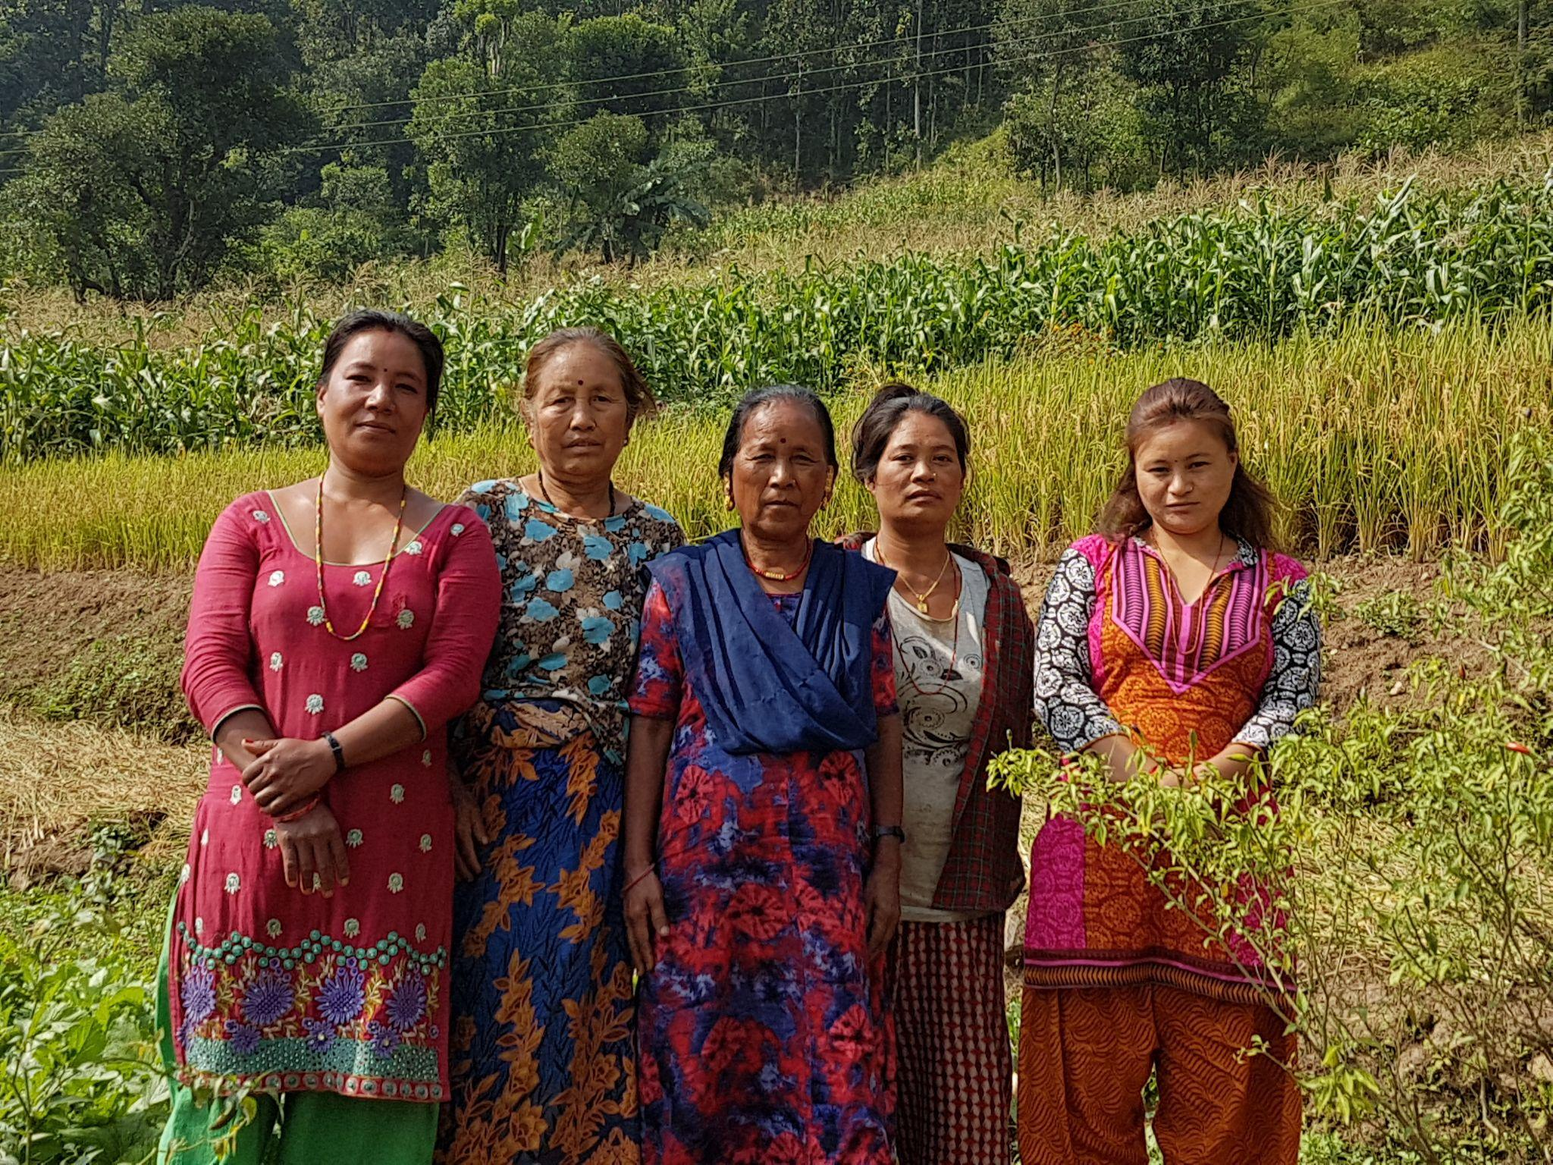
What Are the real
SOLUTIONs?
Many frontline forest communities around the world are demanding and even implementing real solutions to the climate crisis.
Real solutions involve:
guaranteeing collective rights to forests, land, and water
conserving and protecting biodiversity and ecosystem functions
ensuring gender, climate, and social justice

Slide 4
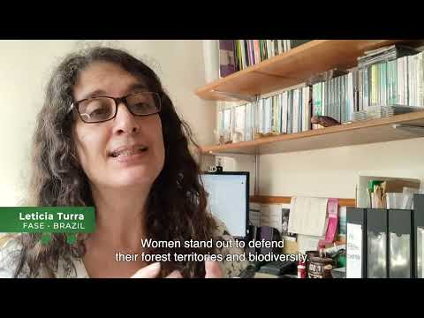
Where can I find out MORE ABOUT real solutions?
Video:
What are the real solutions to the climate change crisis?
6 min.

Slide 5
Where can I find out MORE ABOUT real solutions?
Read: The End of False Solutions: Moving Towards Rights-based and Gender-transformative Solutions to Climate Change (published 3 November 2022)
Articles on: climate colonialism, IPCC reports, Colombia, South Africa, Uganda, Nepal, and false solutions broadly.
See the press release from 3 Nov: International community must end greenwashing…

Slide 6
Where can I find out MORE ABOUT real solutions?
November 14 & 15
Exhibits Booth @COP27
“Net Gain” is a lose-lose for rights, gender justice and social equity in biodiversity policy
Gender justice and climate action: A feminist analysis of forest and climate policy-making
A Gendered Perspective on the Proposed EU Regulation on Deforestation-Free Products
The industrialisation of forest-based bioenergy in Nepal and its impacts on women and other forest-dependent peoples
Whose Land, Whose Forests? The Gendered Impacts and Colonial Roots of Extractive Industries
Gender justice and livestock farming: A feminist analysis of livestock and forest policy-making
Report: The State of Industrial Livestock in Asia and its Impacts on Deforestation and Livelihoods
What are the real solutions to the climate change crisis? [en español | en français]

Slide 7
gfc events at cop27
November 10, 13:30-14:00
Press Conference: The Roadmap to Ending False Climate Change Solutions.
Press Conference Room - Luxor. Taba Area, Hybrid.
November 11, 14.30-15.45
Event at Food4Climate Pavilion: No More Omissions: Real Policy Action on Land Use, Animal Ag. & GHGs
November 12, 13:15-14:45
Side-event: Build a Future of Real Solutions, not a Fossil Fuel House of Cards
Room Akhenaten. Hosted by Demand Climate Justice & member groups CAI, CEO, FOEI, GFC, HOMEF, IEN
November 14, 12.30-13.45 EET
Food4Climate Pavilion: Livestock and Feed Crops Impact Women and Communities: Achieving Climate & Gender Justice through Intersectional Policies & Programs

Slide 8
Gfc events at cop27
November 15, 14.30-15.45 EET
Food4Climate Pavilion: Deindustrialization for Transformation – Seeds become Forests and Food in the Hands of those who Care for the land
November 16, 15.00-16.00 EET
Food4Climate Pavilion: Workshop: Stop Financing Factory Farming Campaign: The Role of Multilateral Finance
18:00-19:30 EET
Panel discussion: Implications of Articles 6.4 and 6.8. 7:30pm
People's Power Room
November 17, 16:30-17:00 EET
Press Conference: An Overview of COP27 from a Gendered and Decolonial Perspective
Press Conference Room - Luxor. Taba Area, Hybrid.

Slide 9
Gfc spokespersons at cop27
Souparna Lahiri, GFC. Article 6, NBS, Net Zero. Contact: 91 98181 47740
Coraina Plaza, GFC. Gender, Koronivia WG Agriculture, Finance. Contact: 31626290703.
Andrey Laletin, FSF/GFC. 1.5-2 degrees, NDCs, Agriculture, Article 6. Contact: 79504351945
Simone Lovera, GFC. NBS, Links with CBD, Gender. Contact: 595981407375
Milena Bernal, GFC. Agriculture, NDCs, Gender, Finance. Contact: 12698738627
Maureen Santos, FASE. Article 6, Koronivia, Net zero, NbS, Forests. Contact: 5521 988695323
Leticia Tura, FASE. Koronivia, Indigenous Platform, Forests and Finance. Contact: 5521 986361358
Dil Raj, FECOFUN Nepal. Indigenous Platform, Net Zero, NbS, Biodiversity. Contact: 9779851258370
Elena Kreuzberg, CPAWS-OV. Forest Biodiversity, Ecosystem Protection. Contact: 16132976405
Ken Kinney, The Development Institute. Article 6, NbS, Agriculture. Contact: 233208192239
Go Takahashi. ASEAN Green Justice Network. Indigenous Platform, Biodiversity. Cont: 819051855439

Slide 10
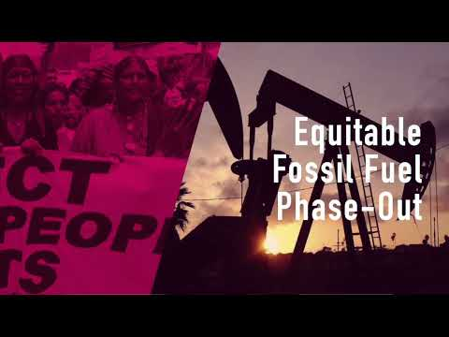
MEDIA STATEMENTS
VIDEO:
Souparna Lahiri on the fight for an equitable fossil fuel phaseout, and the need to mobilise inside and outside COP

Slide 11
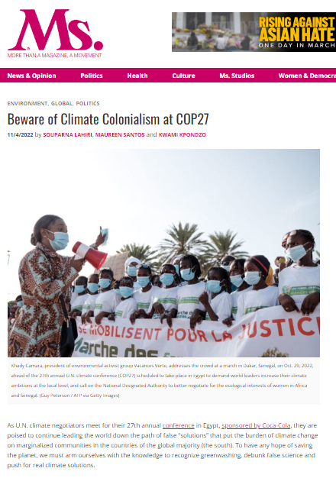
MEDIA STATEMENTS
OP-ED:
Beware of Climate Colonialism at COP27
“A climate COP has its own dynamics, where global political issues and corporate lobbying often cloud the negotiating table, and COP27 may not tread a much different path. But its corridors will reverberate with the demands of the climate justice movement. It is our role to ensure that the world is not deceived by the false solutions and empty promises trumpeted at these events. We need genuine action and real solutions.”

Slide 12
MEDIA STATEMENTS
PRESS RELEASE:
Foxes Guard the Net Zero Henhouse
Coraina de la Plaza (GFC): “For three decades the world’s largest polluters have treated the UNFCCC like a trade show. Corporate sponsors for policy talks. Hundreds of industry lobbyists working the halls. Endless hoopla for non-binding, ineffectual corporate initiatives. Enough is enough, the corporate capture of this space must end and big polluters cannot have a say in the UNFCCC anymore”.

Slide 13
MEDIA STATEMENTS
PRESS RELEASE:
‘No room for offsets’ confirmed by ‘Land Gap’ report
Souparna Lahiri (GFC): “It was clear from the Bonn meetings in June that the Article 6.8 and the non-market approach to joint adaptation and mitigation is ready for operationalization at COP27. That should be in the agenda of the SBSTA Chair and the COP Presidency. Operationalisation of Article 6.8 will realise the demand of the Indigenous Peoples and frontline communities for direct access to climate finance and facilitate real climate solutions to real zero.”

Slide 14
#OurNatureIsNotYourSolution
#DecolonizeClimateSolutions
#STOPFINANCINGFACTORYFARMING
🌐 https://globalforestcoalition.org
Facebook @globalforestcoalition
Twitter @GFC_forests
Instagram @global.forest

